Slide 1
Apache Kafka

Slide 2
Table of Content
Intro to Kafka
How Kafka Works
Role of Zookeeper
Kafka Commands
Spark Streaming
Spark Streaming + Kafka

Slide 3
Intro to Kafka

Slide 4
What is real-time data?
Real-time data is information that is delivered immediately after collection
There is no delay in the timeliness of the information provided
Such data is usually processed using real-time computing
Examples: Log files, e-commerce purchases, weather events, utility service usage, geo-location of people and things, server activity, etc

Slide 5
What is real-time data?
Many companies require real-time analytics to understand what's happening across their business units
Typical industries that rely on real-time data analytics include:
Information technology
Financial services
Transportation
Healthcare
Advertising

Slide 6
Challenges with real-time data
Traditional batch distributed data processing methods require data to be downloaded as batches before it can be processed, stored, or analyzed
Also, point-to-point data pipeline make a system more complicated

Slide 7
Challenges with real-time data
This is how a typical point-to-point data pipeline looks like
Service
Hadoop
Frontend
Security systems
Frontend
Real-time Monitoring
Data Warehouse
As you add more components the system gets more complicated

Slide 8
Solution
This problem can be solved by using messaging system
Messaging systems provides seamless integration among various distributed endpoints with the help of messages

Slide 9

Solution
Using the publish-subscribe feature, kafka decouples data pipelines
Service
Hadoop
Frontend
Security systems
Frontend
Real-time Monitoring
Data Warehouse

Slide 10
Intro to Kafka
Kafka is a distributed streaming platform that is used to publish and subscribe to streams of records
Kafka is used:
to collect big data (real-time streams of data)
to do real time analysis or
both
It can work with Flume, Spark Streaming, Storm, HBase, Flink for real-time ingesting, analysis and processing of streaming data

Slide 11

Kafka is publish-subscribe messaging system and a robust queue that can handle a high volume of data and enables you to pass messages from one end-point to another

Slide 12
How Kafka Works?

Slide 13
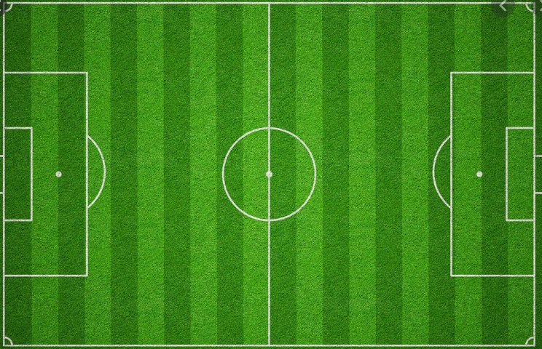
How Kafka Works
Imagine you were to design a system that listens to various football game updates from various sources

Slide 14



How Kafka Works
Such updates might include game scores, countries, players, commentaries and timing information (half time, full-time etc.)

Slide 15
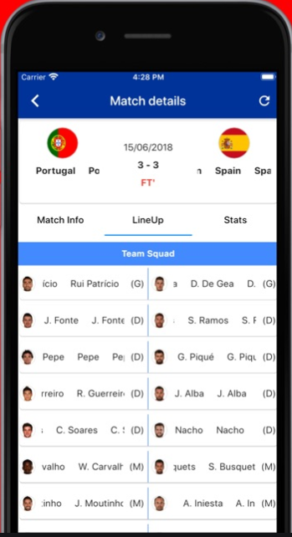
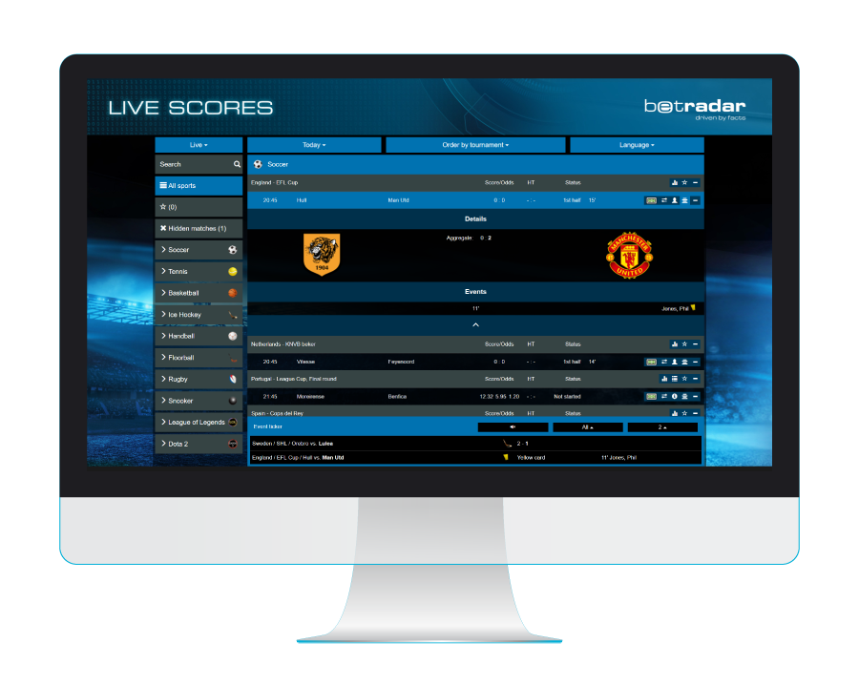
How Kafka Works
It then displays the game status on various channels like mobile application, web browsers, etc

Slide 16
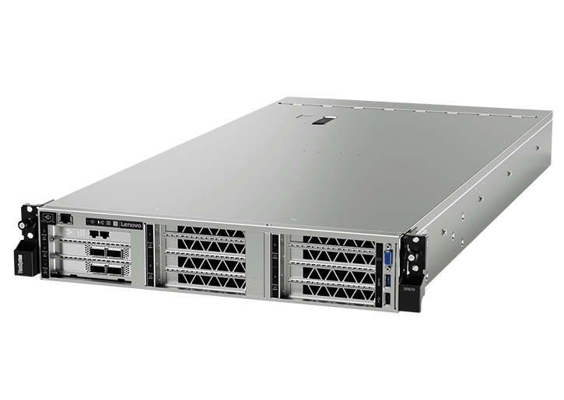
How Kafka Works
In our architecture, we have a process that reads these updates and writes them in a queue, we call these process as producers since it is producing these updates
Producers
Queue

Slide 17
How Kafka Works
At the head of these queue, we have platforms that consumes these updates to display, we call these platforms as consumers
Consumer Mobile
Producers
Queue
Consumer Computer

Slide 18
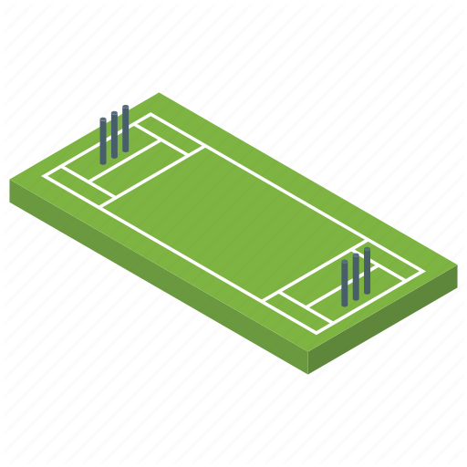


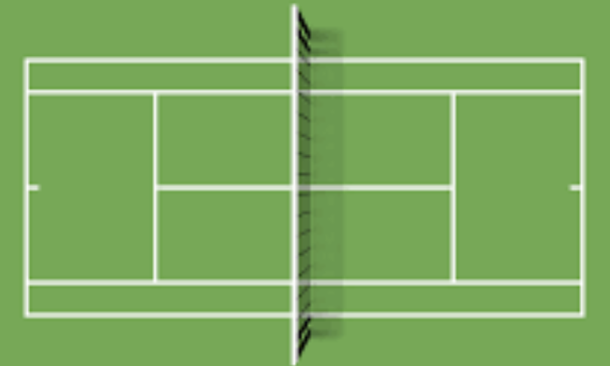

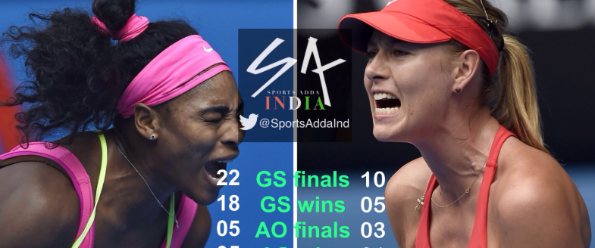
How Kafka Works
Over time we decide to expand and start following more and more games
Consumer Mobile
Producers
Queue
Consumer Computer

Slide 19
How Kafka Works
The problem is that the servers are now struggling handling the load
This is mainly because the queue is hosted on one server which is running out of memory and processing capacity
At the same time the consumers are also struggling in a similar fashion
How can we improve the computing power of this architecture?

Slide 20
How Kafka Works
We need to distribute our architecture
Consumer Mobile
Producers
RF: 6 6 -
RN: 7 1 -
Red Card
Score:
IND: 210 - 8
Score: 1 - 0
Score:
IND: 75 - 1
Match Starts
Consumer Computer

Slide 21
How Kafka Works
By its nature the item in the queue follow specific ordering
Consumer Mobile
Producers
RF: 6 6 -
RN: 7 1 -
Red Card
Score:
IND: 210 - 8
Score: 1 - 0
Score:
IND: 75 - 1
Match Starts
Consumer Computer

Slide 22
How Kafka Works
We could randomly distribute the contents of the queue on to multiple queues
Consumer Mobile
Red Card
Score:
IND: 75 - 1
Producers
Score:
IND: 210 - 8
Match Starts
Consumer Computer
Score: 1 - 0
RF: 6 6 -
RN: 7 1 -

Slide 23
How Kafka Works
If we do this our consumers might consume the updates in the wrong order
This would result in inconsistencies. For example the wrong scores being displayed across the channels

Slide 24
How Kafka Works
One solution is to let the application specify to distribute the items in the queue
In our example we could distribute the item using the match name
Meaning that the update coming from the same match would be on the same queue
This strategy would maintain an ordering for football match. This is the basic fundamental difference between kafka and other messaging system i.e the items sent and received by kafka requires a distributed strategy

Slide 25
How Kafka Works
Consumer Mobile
Score:
IND: 210 - 8
Score:
IND: 75 - 1
Producers
Red Card
Score: 1 - 0
Match Starts
RF: 6 6 -
RN: 7 1 -
Consumer Computer

Slide 26
How Kafka Works
In Kafka, each one of these is called Partitions and the total number of Partitions is called as Partition Counts
Partition 0
Partition 1
Red Card
Score: 1 - 0
Match Starts
Partition 2
RF: 6 6 -
RN: 7 1 -

Slide 27
How Kafka Works
Each server holding one or more of these partitions is called as Broker
Partition 0
Partition 1
Red Card
Score: 1 - 0
Match Starts
Partition 2
RF: 6 6 -
RN: 7 1 -
Broker

Slide 28
How Kafka Works
Each item in the partition is called as Record
Partition 0
Partition 1
Red Card
Score: 1 - 0
Match Starts
Record
Partition 2
RF: 6 6 -
RN: 7 1 -
Broker

Slide 29
How Kafka Works
The field used to decide which partition the record should be stored is called the Partition Key
Partition Key = Match Name
(eg. ‘Germany vs Spain)
Partition 0
Partition 1
Red Card
Score: 1 - 0
Match Starts
Record
Partition 2
RF: 6 6 -
RN: 7 1 -
Broker

Slide 30

If no key is specified Kafka simply assigns a random partition

Slide 31
How Kafka Works
A grouping of partitions handling the same type of data is called a topic
Partition Key = Match Name
(eg. ‘Germany vs Spain)
Partition 0
Topic
Partition 1
Red Card
Score: 1 - 0
Match Starts
Record
Partition 2
RF: 6 6 -
RN: 7 1 -
Broker

Slide 32
How Kafka Works
In order to identify each record uniquely, Kafka provides a sequential number to each record which is called an offset
Partition 0
3
2
1
0
Topic
Partition 1
Red Card
Score: 1 - 0
Match Starts
Record
Partition 2
RF: 6 6 -
RN: 7 1 -
Broker

Slide 33
You can also parallelize the consumer applications having one consumer per partition guarantees ordering a game. Consumers can live on one machine or distributed among multiple ones.
One important concept in kafka is that the consumers are very light weight, we can create many of them without affecting performance. This is mainly because Kafka only needs to maintain the latest offset read by each consumer.

Slide 34
Consumer Mobile
Consumer Computer
Consumer Mobile
Consumer Computer
Red Card
Score: 1 - 0
Match Starts
Consumer Mobile
Consumer Computer
RF: 6 6 -
RN: 7 1 -
Consumer Mobile
Consumer Computer

Slide 35
Consumer Mobile
Consumer Computer
Consumer Mobile
Consumer Computer
Red Card
Score: 1 - 0
Match Starts
Consumer Mobile
Consumer Computer
RF: 6 6 -
RN: 7 1 -
Consumer Mobile
Consumer Computer

Slide 36
Consumer Mobile
Consumer Computer
Consumer Mobile
Consumer Computer
Red Card
Score: 1 - 0
Match Starts
Consumer Mobile
Consumer Computer
RF: 6 6 -
RN: 7 1 -
Consumer Mobile
Consumer Computer

Slide 37
Consumer Mobile
Consumer Computer
Consumer Mobile
Consumer Computer
Red Card
Score: 1 - 0
Match Starts
Consumer Mobile
Consumer Computer
RF: 6 6 -
RN: 7 1 -
Consumer Mobile
Consumer Computer

Slide 38
How Kafka Works
How can kafka determine the record has been consumed and it can safely deleted so it can free up space?
………………
………………
………………
………………
………………
………………
………………
………………
107
106
105
104
103
102
101
100

Slide 39
How Kafka Works
Kafka provide various policies that allow it to do a record cleanup for example, using a retention policy you can provide a record age limit, say, 24 hours
Older than 24 hours records
………………
………………
………………
………………
………………
………………
………………
………………
107
106
105
104
103
102
101
100

Slide 40
How Kafka Works
If retention is configured for n days, then messages once published it is available for consumption for configured days and thereafter they are discarded
Older than 24 hours records
………………
………………
………………
………………
………………
107
106
105
104
103
After which the records are automatically deleted. Using this policy, your consumer is never down for more than this age limit - no messages are lost

Slide 41
Fault Tolerance and Durability

Slide 42
Fault Tolerance and Durability
Each record is stored on a persistent storage so that if a broker goes down, it can recover when it comes back up
………………
………………
………………
………………
………………
………………
………………
………………
107
106
105
104
103
102
101
100

Slide 43
Fault Tolerance and Durability
Kafka replicates partitions so that when a broker goes down a backup partition takes over and processing can resume
Partition Leader
Broker 2
Broker 3
Broker 1

Slide 44
Fault Tolerance and Durability
This replication is configured using a replication factor. For example, a replication factor of 3 leads to 3 copies of the partition
Partition Leader
Partition Backup1
Partition Backup2
Broker 2
Broker 3
Broker 1
Replication Factor = 3

Slide 45

Fault Tolerance and Durability
This means it can tolerate up to two broker servers going down at the same time
Partition Leader
Partition Backup1
Partition Backup2
Broker 2
Broker 3
Broker 1
Replication Factor = 3

Slide 46
For a topic with replication factor N, Kafka can tolerate up to n-1 server failures without losing any messages.

Slide 47
Types of Kafka Cluster
Types of Kafka Cluster:
Single Node – Single Broker Cluster:
Single Node – Multiple Broker Cluster
Multiple Nodes – Multiple Broker Cluster
Kafka Cluster can run against the following broker model:
Single Broker Cluster
Multi Broker Cluster

Slide 48
Role of Zookeeper

Slide 49
Role of Zookeeper
Apache Zookeeper is an open source project that provides a centralized infrastructure that enables synchronization across cluster
It is a centralized service for maintaining configuration information, naming, providing distributed synchronization, and providing group services
All of these kinds of services are used in some form or another by distributed applications

Slide 50
Role of Zookeeper
Each Kafka broker coordinates with other Kafka brokers using Zookeeper
Producers and consumers are notified by Zookeeper service about the presence of new broker in Kafka system or failure of the broker in Kafka system
Zookeeper is mainly used to track status of nodes present in Kafka cluster and also to keep track of Kafka topics, messages, etc

Slide 51
Kafka Commands

Slide 52
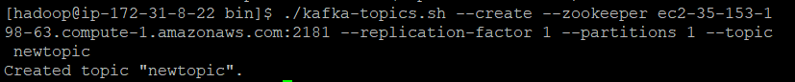
Create Kafka Topic
Kafka command to create topic
kafka-topics --create zookeeper ip-address:2181 --replication-factor n --partition n --topic topic_name

Slide 53
List Kafka Topics
Kafka command to list created topics
kafka-topics --list --zookeeper ip-address:2181

Slide 54
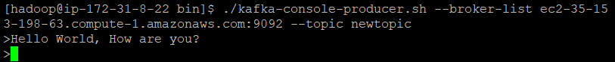
Producer
Kafka command to create a producer and publishing to topic
Kafka-console-producer --broker-list ip-address:9092 --topic topic_name

Slide 55
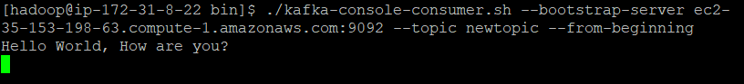
Consumer
Kafka command to create a consumer and subscribing to a topic
Kafka-console-consumer --bootstrap-server ip-address:9092 --topic topic_name --from-beginning

Slide 56
If no key is specified Kafka simply assigns a random partition

Slide 57
For Multi Broker Kafka Cluster
Kafka command to create a consumer and subscribing to a topic
Kafka-console-consumer --bootstrap-server ip-address:9092 --topic topic_name --from-beginning

Slide 58
Summary
Real-time data is information that is delivered immediately after collection
Messaging systems provides seamless integration among various distributed endpoints with the help of messages in real-time
Kafka is a distributed streaming platform that is used to publish and subscribe to streams of records
Kafka provide various policies that allow it to do a record cleanup using a retention policy
Kafka is a durable and fault-tolerant system
Each Kafka broker coordinates with other Kafka brokers using Zookeeper

Slide 59
Thank You

